Slide 1



Slide 2



Slide 3

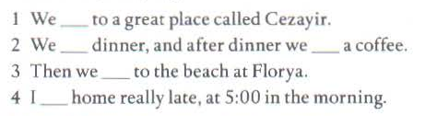
went
had
had
went
got

Slide 4



Slide 5
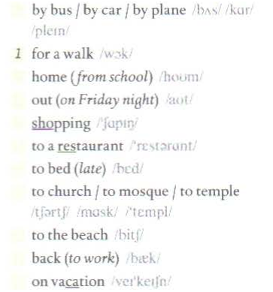
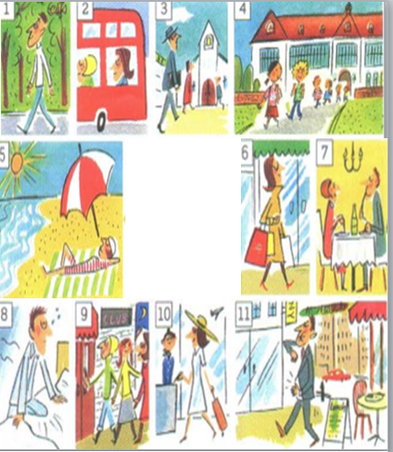
2
4
9
go
6
7
8
3
5
11
10

Slide 6
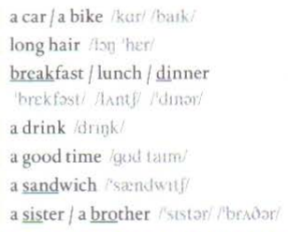
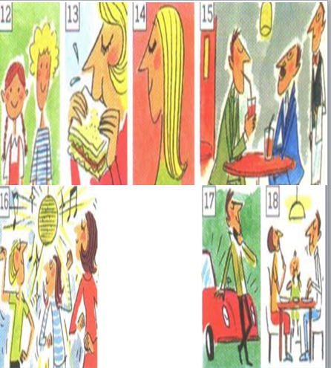
17
14
18
15
16
have
13
12

Slide 7
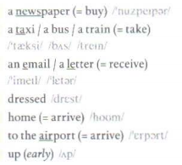
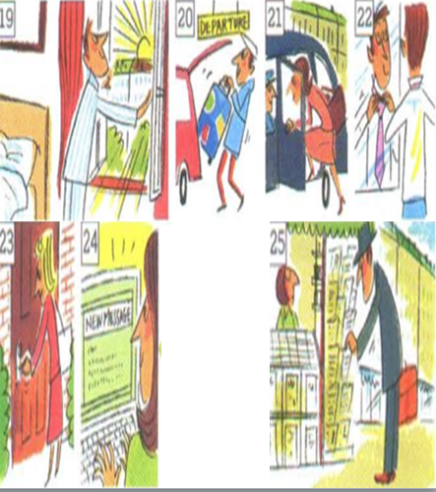
25
21
24
22
get
23
20
19

Slide 8
REVISION
FORM of Simple past tense
(+)
S + V(2/ed) + O
(-)
S + didn’t + V(bare-inf) + O
(?)
Did + S + V(bare-inf) + O ?

Slide 9

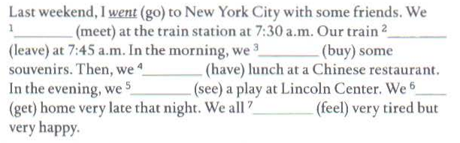
EXERCISE
met
left
bought
had
saw
got
felt

Slide 10
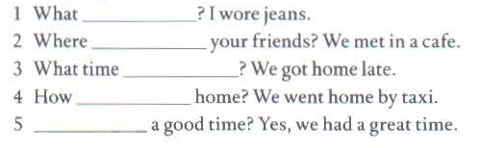

Slide 11




did you wear
did you meet
did you get home
did you go
Did you have

Slide 12

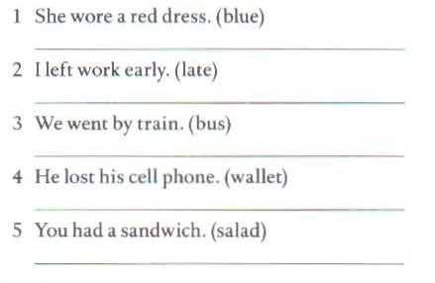
She wore a blue dress.
I left work late.
We went by bus.
He lost his wallet.
You had a salad.

Slide 13


Slide 14

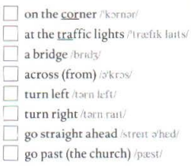
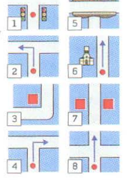
3
1
5
7
2
4
8
6

Slide 15
HOMEWORK
- Learn vocabulary by hearth.
- Prepare next lessons.

Slide 16

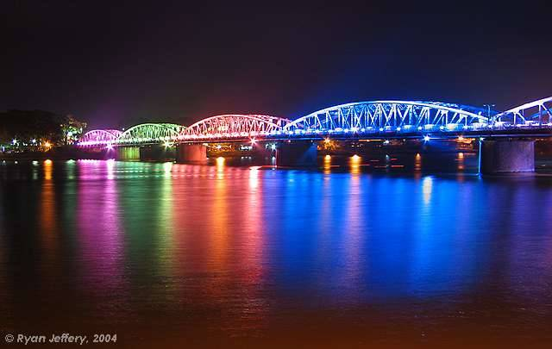


Thank you for your attention!

